Slide 1
What is Snowflake?

Slide 2
Snowflake is a cloud-based data warehousing platform known for its scalability and flexibility.
Snowflake provides a robust solution for storing, managing/processing, and analyzing large datasets in the cloud.
It works on structured, unstructured and semi-structured data’s

Slide 3
Snowflake is a Software-as-a-Service (SaaS), ie the software is already built and accessible via internet
Its architecture separates compute from storage, allowing organizations to scale each independently and pay only for what they use..

Slide 4
 | Traditional Data Warehouses | Snowflake
Storage & Compute | Tightly coupled, high cost | Separated, cost-efficient
Scalability | Limited, hardware-dependent | Elastic, on-demand scaling
Performance | Bottlenecks with high workloads | Multi-cluster compute, no slowdowns
Data Handling | Best for structured data only | Supports structured & semi-structured data
Maintenance | High IT involvement | Fully managed SaaS
Security & Compliance | Requires in-house setup | Built-in enterprise-grade security

Slide 5
Feature | Traditional Data Warehouses | Snowflake
Query Performance | Can slow down under high loads | Multi-cluster architecture ensures smooth performance
Scalability | Requires costly hardware upgrades | Auto-scales compute & storage independently
Concurrency Handling | Queries compete for resources, slowing performance | Each query gets dedicated compute resources
Cost Efficiency | Fixed costs, even for unused resources | Pay-as-you-go model, reducing waste
Maintenance | Requires IT teams for monitoring & tuning | Fully managed SaaS, no manual intervention needed

Slide 6
Features of snowflake
Separation of Storage and Compute: Scale storage and compute power independently, paying only for what you use.
Multi-Cluster Shared Data: Multiple compute clusters can access the same data simultaneously without resource contention.
Zero-Copy Cloning: Create instant, logical copies of databases or tables or schema without physically duplicating data or incurring additional storage costs until changes are made.
Time Travel: Query and restore historical data that has been altered or deleted for up to 90 days.
Secure Data Sharing: Share live, real-time data with other accounts or external partners without copying or moving files.
Support for Semi-Structured Data: Natively handles formats like JSON, Avro, Parquet, and XML using a specialized VARIANT data type.
Auto-Scaling & Concurrency: Automatically expands compute resources to handle peak user demands and shrinks them when idle to optimize costs.
Near-Zero Management: Automates database optimization, indexing, and software updates, eliminating the need for manual tuning or hardware management.
Snowgrid (Multi-Cloud): Provides a consistent experience across AWS, Azure, and Google Cloud, allowing for global data replication and disaster recovery.

Slide 7
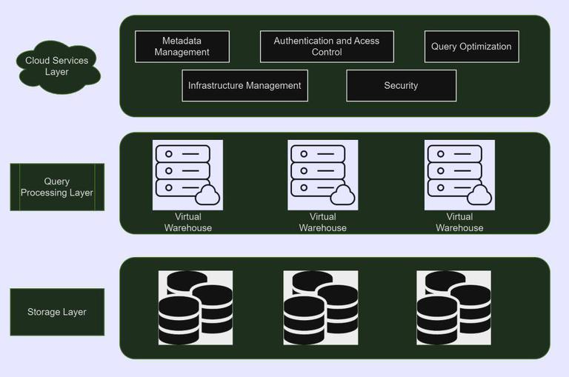
Snowflake architecture

Slide 8
Data storage layer
All data in Snowflake tables is automatically divided into micro-partitions, which are contiguous units of storage. Micro-partitions improve efficiency and provide other benefits.
It stores structured, semi-structured and unstructured data
Structured data — such as rows and columns in a table — follows a strict tabular schema.
Semi-structured data — such as a JSON file or an XML file — has a flexible schema.
Unstructured data — such as a document, image, or audio file — has no inherent schema.

Slide 9
When you load data into Snowflake, it is automatically reorganized into an internally optimized, compressed, and columnar format.
Micro-partitions: Data is stored in small, contiguous units of storage called micro-partitions, which enhance query efficiency by allowing the system to scan only the necessary data.

Slide 10
Query processing layer/compute layer
This layer handles actual query execution using MPP (massively parallel processing) compute clusters known as Virtual Warehouses
A virtual warehouse is a cluster of compute resources in Snowflake
Independent Scaling: Each virtual warehouse is a separate compute cluster that does not share resources with others.
Elasticity: Warehouses can be resized, paused, or resumed instantly, and you only pay for the compute time you actually use

Slide 11
Cloud services layer
Brain of the system
the Cloud Services Layer serves as the control plane, managing information, security, and user access.

Slide 12
Editions
Standard
Standard Edition is our introductory level offering, providing full, unlimited access to all of Snowflake’s standard features.
Enterprise
Enterprise Edition provides all the features and services of Standard Edition, with additional features that are designed specifically for the needs of large-scale enterprises and organizations.

Slide 13
Business Critical
It includes all the features and services of Enterprise Edition, with the addition of enhanced security and data protection. In addition, account failover/failback adds support for business continuity and disaster recovery.
Virtual Private Snowflake (VPS)
It includes all the features and services of Business Critical Edition, but in a completely separate Snowflake environment, isolated from all other Snowflake accounts (i.e. VPS accounts do not share any type of hardware resources with accounts outside the VPS).
Virtual Private Snowflake offers our highest level of security for organizations that have the strictest requirements, such as financial institutions and any other large enterprises that collect, analyze, and share highly sensitive data.

Slide 14
Pricing
Your total bill is primarily driven by three main pillars: Compute, Storage, and Cloud Services.
Compute (virtual warehouse)
Compute is typically the largest part of a Snowflake bill (often 80% or more). It is measured in Snowflake Credits
Virtual Warehouses: These are clusters of resources used to run queries and load data. They come in "T-shirt sizes" (XS to 6XL), where each larger size doubles the compute power and the credit consumption per hour.
Per-Second Billing: You are billed for credits per second while a warehouse is running, with a 60-second minimum each time it starts.

Slide 15
2) Storage
Snowflake charges a monthly fee based on the average amount of compressed data stored per month
3) Cloud services layer
This layer handles metadata, query optimization, and security
10% Adjustment: Most customers pay $0 for this. Snowflake only bills for cloud services if their daily usage exceeds 10% of that day's total warehouse usage

Slide 16
Roles
ACCOUNTADMIN: the "super-user" role that manages the entire account, including billing and account-level parameters. It inherits all privileges from the SYSADMIN and SECURITYADMIN roles.
Orgadmin: a specialized role for managing multiple accounts within an organization.
Securityadmin: responsible for creating and managing users and roles. It has the global MANAGE GRANTS privilege to modify any grant in the account.
Useradmin: a child of securityadmin specifically for creating and managing users and roles.
Sysadmin: the role responsible for creating and managing system-level objects like databases, warehouses, and schemas.
Public: a pseudo-role automatically granted to every user in the account. It provides basic access to objects that are explicitly shared with everyone

